Slide 1

Data Mining/Machine Learning
Personalized Tourism Itinerary Recommender System
Guide: Dr. B Narsing Rao
Team:
Chiranth Gopal K 1PI13CS047
Gourish Hebbar 1PI13CS062

Slide 2
Data Mining/Machine Learning
Problem Statement
To provide personalized itinerary for attractions based on user location and preferences

Slide 3
Data Mining/Machine Learning
Solution
To build a web app using a recommendation engine which generates a path of places to be visited in particular order

Slide 4
Data Mining/Machine Learning
Literature Survey
Web application for recommending personalised mobile tourist routes by D.Gavalas, M. Kenteris, C. Konstantopoulos, G. Pantziou – IET Softw. 2011
Personalized Travel Suggestions for Tourism Websites by António Coelho, André Rodrigues – IEEE 2011
Location-Aware Recommendation Systems by María del Carmen Rodríguez-Hernández, Sergio Ilarri, Raquel Trillo-Lado, Ramón Hermoso - Article 2015

Slide 5
Data Mining/Machine Learning
Team Orienteering Problem (TOP)
As defined in the paper by Gavalas et al “Web application for recommending personalised mobile tourist routes”, TOP involves a complete graph G = (V, E), |V| = n, where each node i, i = 0, ... , n - 1, in V corresponds to a POI and each edge (i, j) in E corresponds to the shortest path (in terms of Manhattan distance d i,j) linking individual POIs i and j.
We assign score to each POI, and the objective function is to maximize the score and use some variation of travelling salesman problem and heuristics to derive near-optimal solution

Slide 6
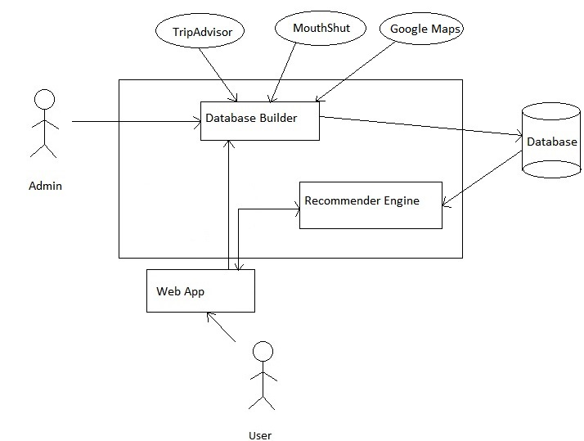
Data Mining/Machine Learning
High Level Architecture

Slide 7
Data Mining/Machine Learning
User inputs
Duration of stay
Start time for the day
End time for the day
Start/end point of the trip
Preferences of place

Slide 8
Data Mining/Machine Learning
Algorithm
Show user recommended places with ratings and suggested time to be spent on the place on a map
Also show other recommendations as a list of places
User can
Modify the time they would want to spend at a place
Add/remove a place from their itinerary using the recommended places list
For stay of multiple days, places visited on the previous days will be excluded from further recommendations

Slide 9
Data Mining/Machine Learning
Deliverables
Tourism database
Database builder
Recommender engine
Web app
Mysore city will be chosen as an example to demonstrate the path recommendations

Slide 10
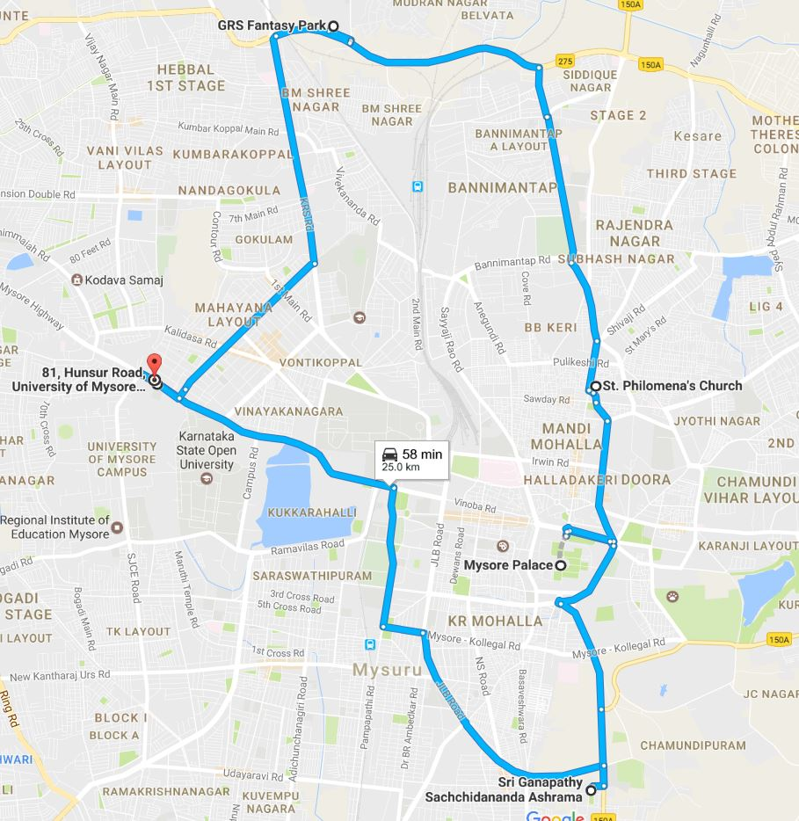
Data Mining/Machine Learning
Sample Solution

